Slide 1
Using Evidence for Policy Impact
IPPO’s Rapid Evidence Review on Net Zero + other Interventions and Opportunities
Jeremy Williams
Senior Research Fellow / Policy Evidence Lead, IPPO, UCL

Slide 2
Agenda
IPPO 101: Problem; Solution; Process
Case Study 1: Net Zero Rapid Evidence Review
Case Study 2: How to Run Society-Wide Conversations on Net Zero
Call for Collaboration

Slide 3
Evidence for Policy: The Problem
The perceived problem:
Policy and evidence are different worlds with differing priorities
My personal experience: both sides of the table
Local government management: focus on the day-to-day
Academic world: focus on the bigger picture

Slide 4
Evidence for Policy: The IPPO Solution
Policy supply/demand
Engagement
Co-design and co-production
…but also Framing
Communicating complexity vs “easy-to-grasp” messaging in outputs
→ Nuances of “behaviours” and “contexts” in the Review
The need to be quasi-journalistic: storytelling, narratives, headlines
…but also how you scope and produce the work + with stakeholders:
+ realistic policy recommendations or options the goal from the start

Slide 5
IPPO 101: What We Do
Double helix: channel evidence supply to service policy demand
Four UK nations + combined/local authorities + global view via INGSA
Outputs and Activity
Formal evidence reviews
Systems maps
Wealth of intelligence, policy briefs, think-pieces from experts – written for a policy audience. All available at theippo.co.uk
Convening and co-production: roundtables, events, seminars, joint products
Net Zero
Home Energy Change
Society-wide Conversations
Food, sustainability, farming
Future: freight, other topics in response to policy demand (get in touch!)

Slide 6
Notes:
We looked a similar European countries with climates that mainly use heat pumps for heating not cooling
Became apparent different countries had different starting points, and home heating mix
Finland started the transition much earlier (70’s) and has created a new normal for heat pumps in new builds has a developed market to meet demand for installation and aftercare,
Their starting context was Oil and wood, UK was mains.
We have more in common with the Netherlands for proportion of home that run on mains gas. 90%
Most of the other countries in the sample offer incentives for new builds as well as retrofits, not necessarily grants, but in the form of tax breaks, retrofits seem to be less popular everywhere
All but Poland, have Created an need for futureproofing by setting an end date to fossil fuels heating in homes - for Norway and Germany and this end date is already in place.
UK has more buildings to retrofit than new builds – and these are older and leakier than for other countries in the sample (no stats for heat loss on Finland, but less than a third of their homes are “old”
We pay more for electricity, so harder to link the benefits of more efficient and greener energy use with lower running costs which you find with other high value high commitment purchases. It costs double to heat leakier homes

Slide 7
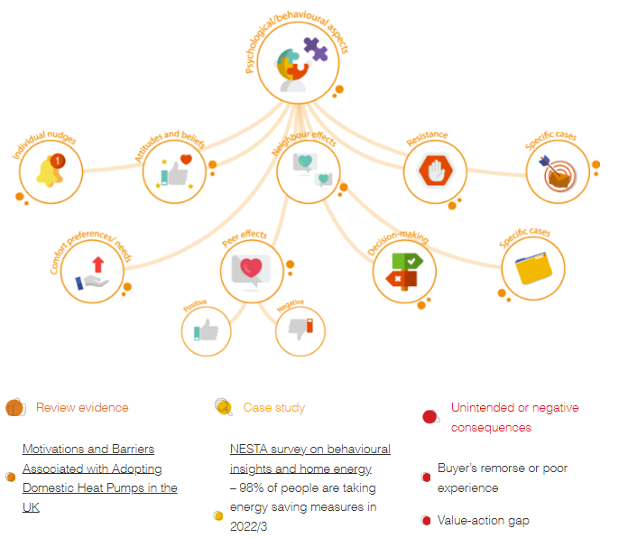
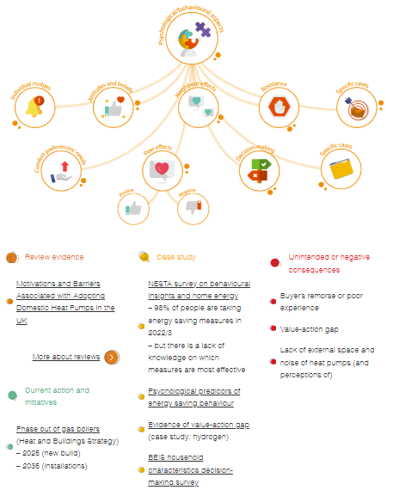
Case Study 1: Home Energy Behaviour Change
IPPO asked to look at this via government meetings
Systems mapping process (SEPPA process)
Initial “brainstorm” with stakeholders
Broader session to populate
“Review of reviews” – strength of evidence
Roundtable of stakeholders
Review of academic literature – this is only one type of knowledge!
Policy options/recommendations via Realist Review

Slide 8
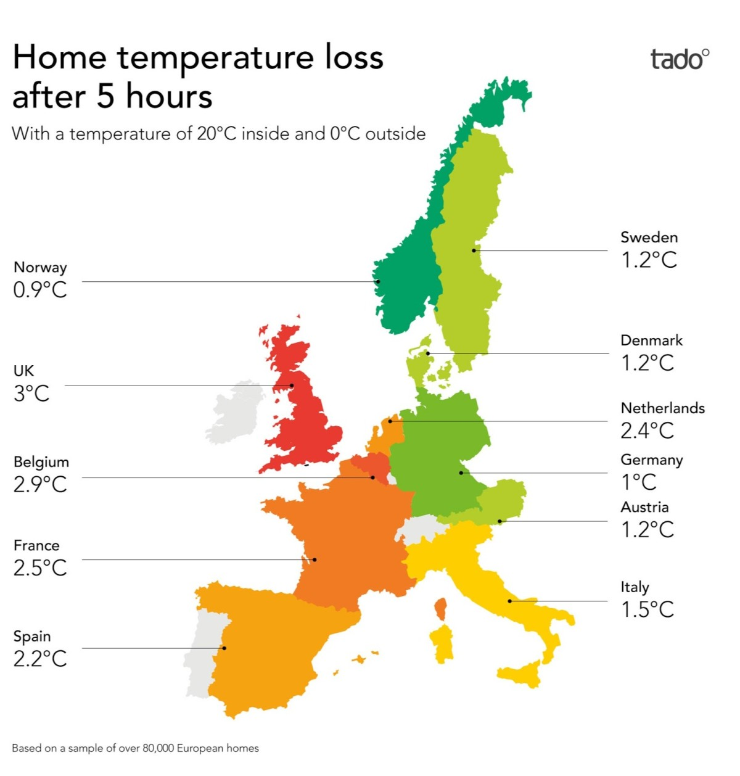
Home Energy: How does the UK Compare?
Notes:
We looked a similar European countries with climates that mainly use heat pumps for heating not cooling
Became apparent different countries had different starting points, and home heating mix
Finland started the transition much earlier (70’s) and has created a new normal for heat pumps in new builds has a developed market to meet demand for installation and aftercare,
Their starting context was Oil and wood, UK was mains.
We have more in common with the Netherlands for proportion of home that run on mains gas. 90%
Most of the other countries in the sample offer incentives for new builds as well as retrofits, not necessarily grants, but in the form of tax breaks, retrofits seem to be less popular everywhere
All but Poland, have Created an need for futureproofing by setting an end date to fossil fuels heating in homes - for Norway and Germany and this end date is already in place.
UK has more buildings to retrofit than new builds – and these are older and leakier than for other countries in the sample (no stats for heat loss on Finland, but less than a third of their homes are “old”
We pay more for electricity, so harder to link the benefits of more efficient and greener energy use with lower running costs which you find with other high value high commitment purchases. It costs double to heat leakier homes

Slide 9
Decarbonising Home Energy: Framing and Principles
Overall framing: the need to change course
UK has most energy inefficient homes and lowest heat pump take-up in Europe
No prospect of achieving Net Zero without radically reducing household carbon emissions
Lower levels of household green purchases are not just about economics or technology → Focus on behaviour/human factors and the contexts that inform them

Slide 10
What helps people choose high value high commitment green purchases?
Green values
Green routines
Evaluation, expectations
Buying power
Infrastructure
Knowledge is power
Risk, resilience, agency
Social space of markets
Credible messenger
Notes:
Things like green homes, home solar systems, electric vehicles, and so on, things that take a lot of thinking about and not so easy to change your mind about , - like green fashion, or sustainable food choices.
Motivations can be automatic, you don’t have to think about them , these are deeply held values and beliefs, convictions. Consensus that green values, environmental concerns, concerns about climate change were the main driver behaviour high value high commitment purchase, but not the only one- it was associated with green routines people who did the big actions like purchase of high values items did the little things too.
Motivation can be activated on reflection, Evaluation against expectations including payback times, and running costs, and performance of the item were also drivers to purchase, and a barrier if they didn’t measure up
Infrastructure refers to the supporting system into which the new purchase operates, if the supporting infrastructure support the use of the item as intended also the ability to get the item serviced, installed, replaced, and so on
Buying power – an actual break on intentions, no money, no purchase,
High value higher purchases needed greater reflection that lower value items ,experiential knowledge was a driver to purchase,
Spcail space of markets – competition, availability, word of mouth,
Risk resilience and agency – the confidence in the future, what is on the horizon, capacity to cope with changes, a feeling of control and power over one’s life and decisions.
A credible messenger can overcome some of the barriers from information asymmetry of new technologies, - neutral third parties and advisors also personal recommendations,

Slide 11
What do we need?
Knowledge is power
Awareness of heat pumps in the general UK population was low. Few opportunities to learn and test and evaluate
Infrastructure
Interventions and incentives tailored to our UK context
Risk, resilience and agency - future proofing the need for a need and a “new normal”
Notes:
Interventions tailored to our UK context
As Decisions based on several domains of influence – interventions and incentives should be too -
It’s a bigger ask than in other countries, the UK could take a more stepped approach – insulation first in readiness for the end date to fossil fuels home heating, and work towards a widespread heat pumps switch
the environmental awareness and will to change is there but cant be relied on alone to make the change. A necessary but not sufficient condition.
To reach net zero targets we need to Widen reach to many more people,, to new builds and people on higher incomes, including grants, but also loans and income based sliding scale of incentives, and tax but encourage incentives from finance for green loans and credit for insulation and heat pump retrofitting together, and encourage retail to reduce the non-financial costs concerns, such providing refunds or buy backs, if not satisfied.
Consider reforming EPC certificates to more accurately reflect home users’ heating behaviours in energy use against building fabric. Make home heating surveys part of the buying process as part of a “new normal” akin to other homebuying surveys.
Decarbonised homes become more desirable to buyers, and linked to property values, as "old systems" become a deferred cost to the buyer.

Slide 12
About the Recommendations
IPPO makes 4 topline recommendations
→ From workstream as a whole including systems mapping + stakeholder engagement
→ Sit above and alongside Key Findings & Recommendations of the Review
We believe these 4 key recommendations are
Relatively simple to implement
Politically non-controversial
Cost-effective
Good prospect of success in increasing green purchase decisions

Slide 13
Our Topline Recommendations
Establish and promote consistent incentive structures for green purchases.
Set up Home Upgrade Agencies to co-ordinate consistent messaging and offer bespoke advice and pathways to householders.
Run a competition promoting innovative ways to minimise the disruption when installing heat pumps.
Capitalise on the additional time available before the phase-out of fossil fuels in home heating in the UK by further prioritising insulation and an attendant programme of activity across society.

Slide 14
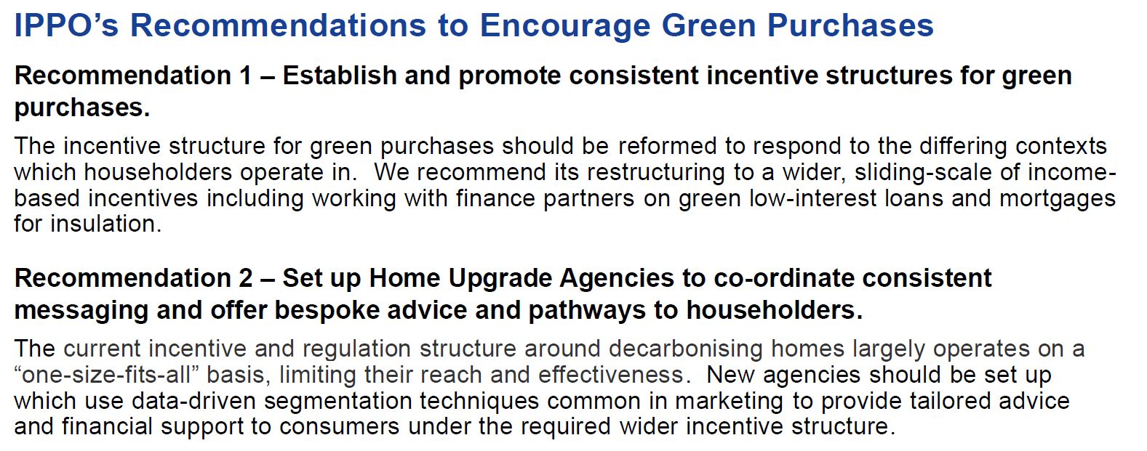
Notes:
Interventions tailored to our UK context
As Decisions based on several domains of influence – interventions and incentives should be too -
It’s a bigger ask than in other countries, the UK could take a more stepped approach – insulation first in readiness for the end date to fossil fuels home heating, and work towards a widespread heat pumps switch
the environmental awareness and will to change is there but cant be relied on alone to make the change. A necessary but not sufficient condition.
To reach net zero targets we need to Widen reach to many more people,, to new builds and people on higher incomes, including grants, but also loans and income based sliding scale of incentives, and tax but encourage incentives from finance for green loans and credit for insulation and heat pump retrofitting together, and encourage retail to reduce the non-financial costs concerns, such providing refunds or buy backs, if not satisfied.
Consider reforming EPC certificates to more accurately reflect home users’ heating behaviours in energy use against building fabric. Make home heating surveys part of the buying process as part of a “new normal” akin to other homebuying surveys.
Decarbonised homes become more desirable to buyers, and linked to property values, as "old systems" become a deferred cost to the buyer.

Slide 15
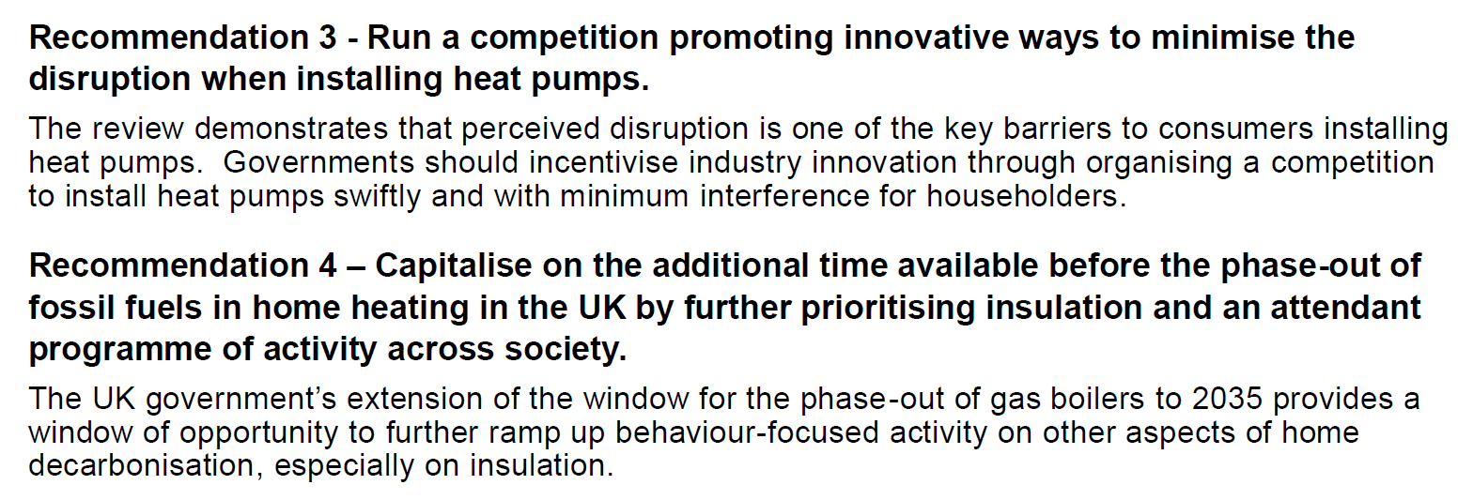
Notes:
Interventions tailored to our UK context
As Decisions based on several domains of influence – interventions and incentives should be too -
It’s a bigger ask than in other countries, the UK could take a more stepped approach – insulation first in readiness for the end date to fossil fuels home heating, and work towards a widespread heat pumps switch
the environmental awareness and will to change is there but cant be relied on alone to make the change. A necessary but not sufficient condition.
To reach net zero targets we need to Widen reach to many more people,, to new builds and people on higher incomes, including grants, but also loans and income based sliding scale of incentives, and tax but encourage incentives from finance for green loans and credit for insulation and heat pump retrofitting together, and encourage retail to reduce the non-financial costs concerns, such providing refunds or buy backs, if not satisfied.
Consider reforming EPC certificates to more accurately reflect home users’ heating behaviours in energy use against building fabric. Make home heating surveys part of the buying process as part of a “new normal” akin to other homebuying surveys.
Decarbonised homes become more desirable to buyers, and linked to property values, as "old systems" become a deferred cost to the buyer.

Slide 16
Next Steps & Questions
Engagement and dissemination with partners across government – UK; national; regional; local
Engagement and dissemination with other strategic partners
… Questions?

Slide 17
Case Study 2: Society-Wide Conversations
IPPO asked by governments for evidence on how to “envisage” Net Zero
The problem:
Politicisation of Net Zero (from expertise to contestation)
The populist shift:
Rejection of institutions / sources of authority (“we’ve had enough of experts”)
Expression in electoral politics + “culture war” debates

Slide 18
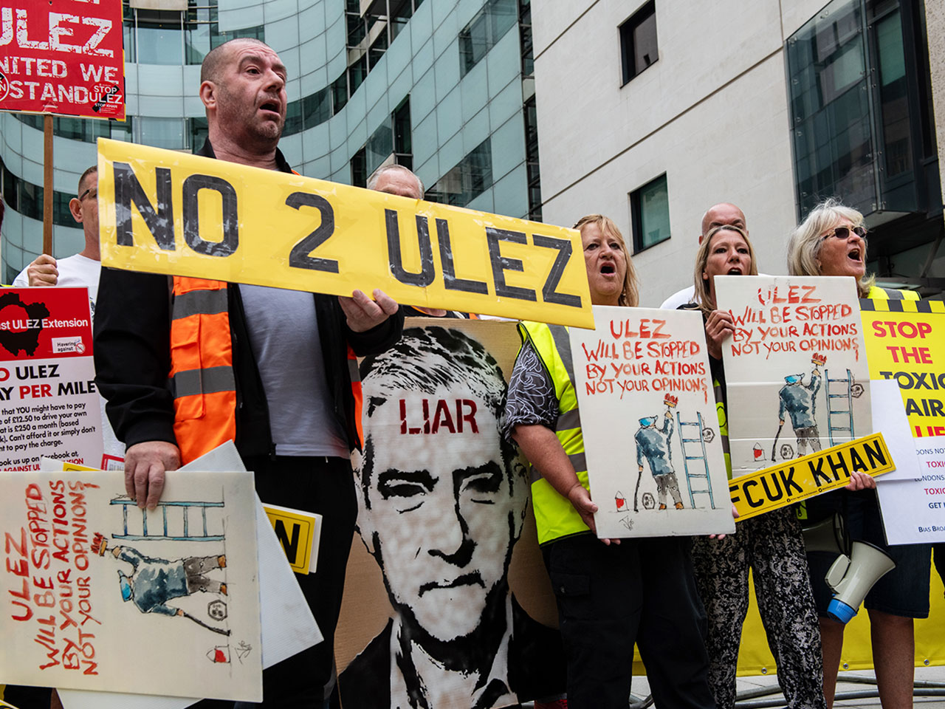
Society-Wide Conversations: IPPO Activity
What we did:
Evidence gathering (all kinds of evidence) – global scan by INGSA, country-specific intelligence, scan of academic literature
Convening: public roundtable – on Net Zero + other examples
Synthesising into policy recommendations + offer to collaborate on implementing

Slide 19
Recommendations for Governments
Use storytelling to make things tangible
Be honest about systemic change – but focus on hope and agency
Invest in communicating – and genuinely listen
Avoid binaries to stop things becoming totemic

Slide 20
Next Steps
Collaboration with a government or local authority on implementation
Offer to set up a conversation on these principles
Are you interested? Let us know!

Slide 21
Call for Collaboration
What do you need from universities/university researchers?
How do you want to work with them?
How might universities/researchers work differently to improve engagement with policy?
How might you/policymakers/practitioners work differently to improve engagement with university researchers?

Slide 22
Thank You and Get in Touch
Jeremy Williams
Senior Research Fellow / Policy Evidence Lead, IPPO, UCL jeremy-williams@ucl.ac.uk
Connect at theippo.co.uk
Twitter/X: @ippouk

