Slide 1
Engaging with university researchers
IPPO Winter School
Queen’s University Belfast, Thursday, 18 January 2024
Sarah Chaytor, Director of Strategy & Policy, UCL Research, Innovation and Global Engagement
Principal Investigator, IPPO
Project lead and Co-Investigator, CAPE
Co-Chair, UPEN

Slide 2
Increasing emphasis on academic-policy engagement
Macro / Societal:
Meso / Institutional:
Micro / Individual:
Project funding
Personal prestige
Career
Do the right thing!
REF impact
Institutional funding
Reputation
Strategic priorities
research budget
better policy decisions
public perception of universities
Over £14bn in public R&D funding in 2023/24
Increasing funder awareness of potential for research impact on policy
Increasing policy demand for evidence
University civic missions

Slide 3
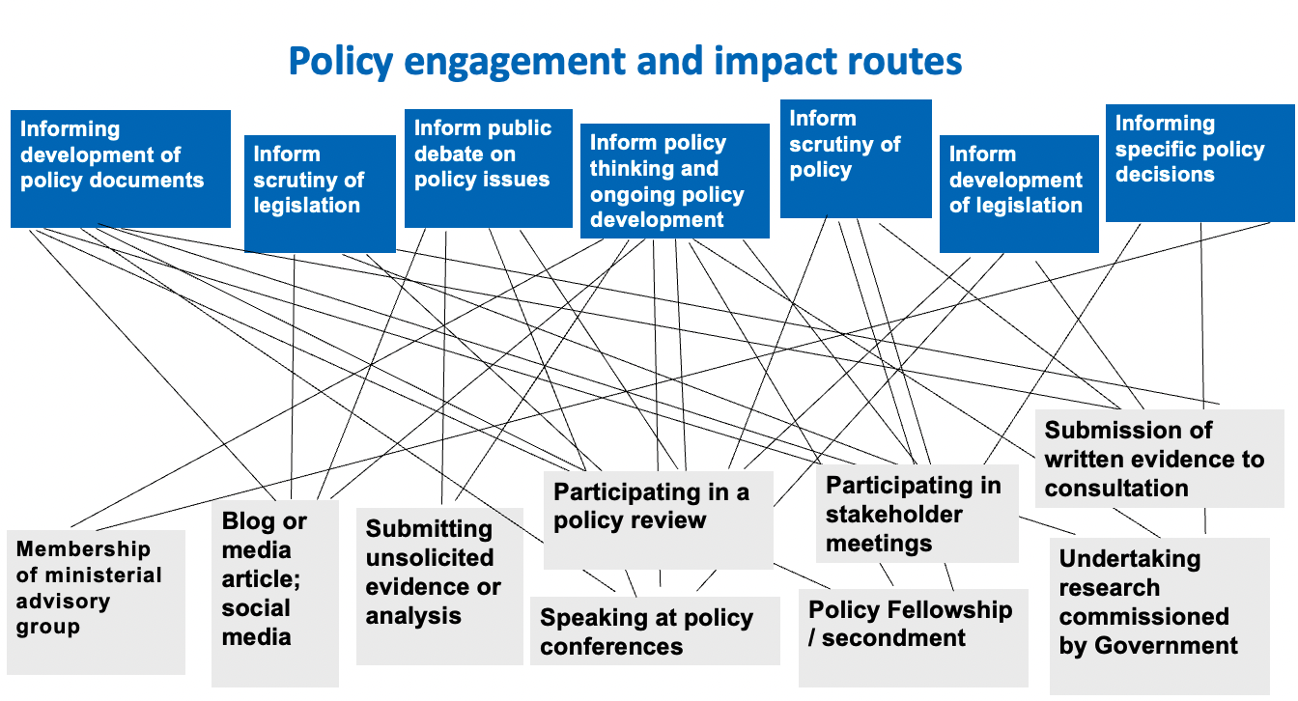
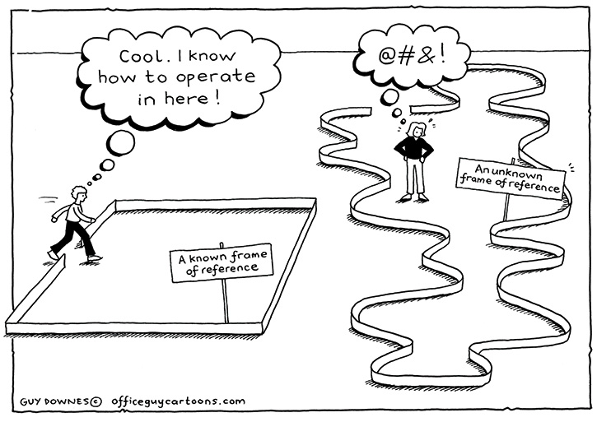
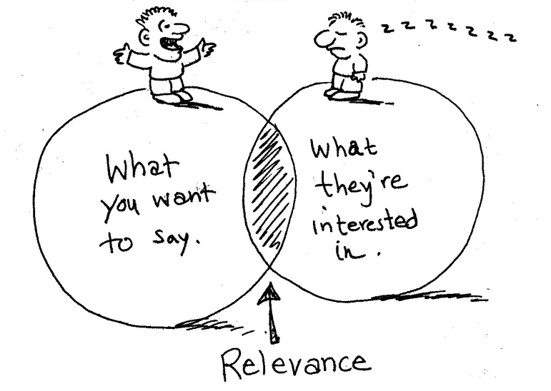
A complex picture
… informing policy is complicated
The UK evidence ecosystem is evolving rapidly…
Source: Chaytor & Reid in Rahman et al . How to Engage Policymakers With Your Research (2022)
YPERN
…and there are persistent obstacles to academic-policy engagement

Slide 4
What do academics think about engaging with policy?
Relationships matter both in the act of engaging with policy and also the outcome of that engagement.
Engaging with policy can be rewarding for academics but it is also hard work and time intensive.
Better systems and structures are needed to support engagement
More time, funding, and reward should be given especially earlier in academic careers
Professional services staff need improved career trajectories.

Slide 5
How do universities support academic-policy engagement?
University-based policy engagement units
UPEN

Slide 6
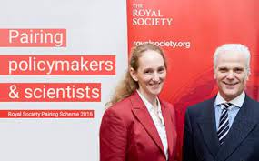
Research funding which can support academic-policy engagement
Policy Fellowships:
Block funding allocations:
QR
- £28.8m for QUB; £14.4m for UU in 22/23)
- No dedicated QR Policy Support Fund as in England
HEIF
- Recurring funding for knowledge exchange and innovation activity
- £4m pa in NI
UKRI Impact Acceleration Accounts
- Block allocation to build on existing research
- UKRI combined IAA: £2.8m to QUB 22-25
- ESRC IAA £1.25m to QUB and £450k to Ulster University 2023-28

Slide 8
What is IPPO focusing on?
Current work:
Society-wide conversations on net zero
Innovation districts
Converting office space to housing
Policy responses to economic inactivity
Role of flexible working in an inclusive economy
Poverty stigma
Access to childcare for ethnic minorities
Local data use
Future responses to fiscal constraint
NET ZERO
SOCIO-ECONOMIC INEQUALITIES
PLACE & SPATIAL INEQUALITIES
COVID-19 IMPACT AND RECOVERY
www.theippo.co.uk

Slide 9
Strengthening academic-policy engagement
Persistent challenges remain
What do we need to strengthen academic –policy engagement and the evidence ecosystem?
Enhance capabilities: relational; translational; curational
Improve incentives for and recognition of policy engagement and knowledge brokerage in policy, professional and academic roles, career pathways and promotions
Sustainable connective infrastructure between university research and public policy and enhanced
Improve coordination of an increasingly complex ecosystem and cross-system and cross-government approaches to evidence use
Creating time and (head) space
Relationships matter
Scoping policy demand
Multiple forms of evidence
Lack of cross-system approach

Slide 10
Questions
What do you need from universities/university researchers?
How do you want to work with them?
How might universities/researchers work differently to improve engagement with policy?
How might you/policymakers/practitioners work differently to improve engagement with university researchers?

